Slide 1

Operating Systems
BCSC 0004
CPU Scheduling
Round Robin

Slide 2
Round Robin (RR)
Each process gets a small unit of CPU time (time quantum), usually 10-100 milliseconds. After this time has elapsed, the process is preempted and added to the end of the ready queue.
If there are n processes in the ready queue and the time quantum is q, then each process gets 1/n of the CPU time in chunks of at most q time units at once. No process waits more than (n-1)q time units.
Performance
  q large ⇒ FIFO
  q small ⇒ q must be large with respect to context switch, otherwise overhead is too high

Slide 3
Example of RR with Time Quantum = 4
Process Burst Time
P₁ 24
P₂ 3
P₃ 3
The Gantt chart is:
AWT= 17/3= 5.66
Typically, higher average turnaround than SJF, but better response
P₁
P₂
P₃
P₁
P₁
P₁
P₁
P₁
0
4
7
10
14
18
22
26
30

Slide 4
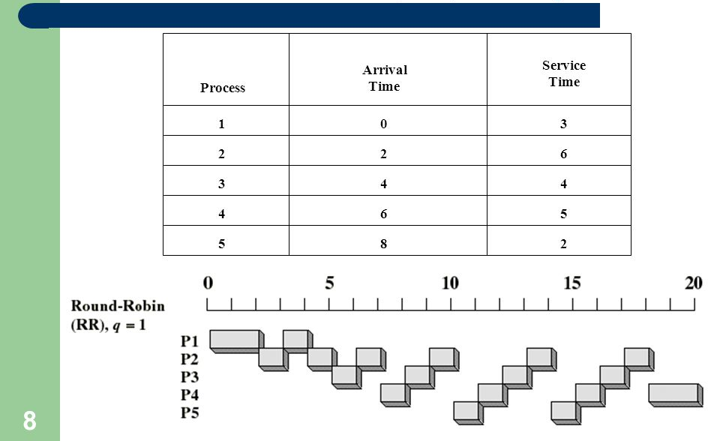

Slide 5
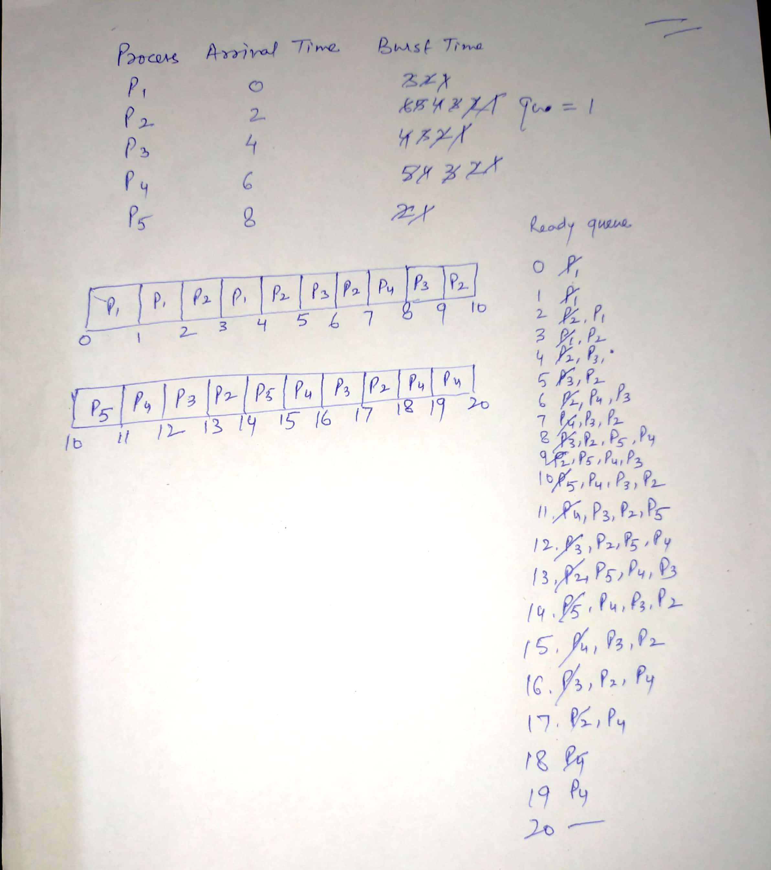

Slide 6

Time Quantum and Context Switch Time

Slide 7

Turnaround Time Varies With The Time Quantum
3 Processes- BT-10 & Quantum time-1: ATT-29
3 Processes- BT-10 & Quantum time-10: ATT-20

Slide 8
Practice Question
Four processes are entering the ready queue at a certain point of time.
Process Arrival Time Burst Time
P1 0.000 4
P2 2.001 7
P3 3.001 2
P4 3.002 2
Draw Gantt chart for illustrating the execution of these processes using FCFS, SJF, SRTF and Round Robin(Quantum=2)
Calculate Average Turn-Around Time for each scheduling algorithm.
Calculate Average Waiting Time for each scheduling algorithm.

Slide 9
Consider the 3 processes, P1, P2 and P3 shown in the table
----------------------------------------------------------
Process Arrival time Time unit required
----------------------------------------------------------
P1 0 5
P2 1 7
P3 3 4
----------------------------------------------------------
The completion order of the 3 processes under the policy RRS (round robin scheduling with CPU quantum of 2 time units) is:
Ans: P1,P3,P2

Slide 10
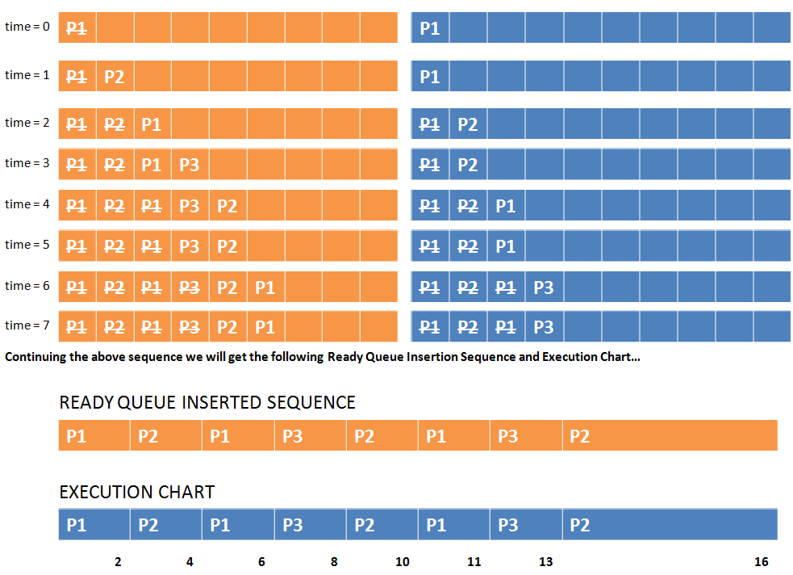

Slide 11
Q2: We wish to schedule three processes P1, P2 and P3 on a uniprocessor system. The priorities, CPU time requirements and arrival times of the processes are as shown below.
Process Priority CPU time Arrival time
P1 10(highest) 20 sec 00:00:05
P2 9 10 sec 00:00:03
P3 8 (lowest) 15 sec 00:00:00
We have a choice of preemptive or non-preemptive scheduling. In preemptive scheduling, a late-arriving higher priority process can preempt a currently running process with lower priority. In non-preemptive scheduling, a late-arriving higher priority process must wait for the currently executing process to complete before it can be scheduled on the processor.
What are the turnaround times (time from arrival till completion) of P2 using preemptive.
Ans: 30

Slide 12
Consider the following CPU processes with arrival times (in milliseconds) and length of CPU bursts (in milliseconds) except for process P4 as given below:
  Process Arrival Time Burst Time
  P1 0 5
  P2 1 1
  P3 3 3
  P4 4 x
If the average waiting time across all processes is 2 milliseconds and pre-emptive shortest remaining time first scheduling algorithm is used to schedule the processes, then find the value of x ?
Ans: 2

Slide 13


